Slide 1
Customer Segmentation
Group Members:
Batool AL-Tarawneh
Gizem Comert
Srijal K c
Tamunotonye Daniel

Slide 2
Agenda
Introduction
Data Set
Data Collection and Preparation
Exploratory Data Analysis (EDA)
Model Selection and Building
Hyperparameter Tuning and Model Evaluation and Validation
Deployment

Slide 3

Introduction
Customer segmentation: is dividing customers into groups of similar individuals in certain marketing-relevant ways, such as age, gender, interests, spending habits, and more. Companies that conduct customer segmentation are based on the premise that every customer is different and that their marketing efforts will be better if they target specific, smaller groups. Companies also hope to understand their customers' preferences and needs by discovering what each segment prefers to tailor marketing materials more precisely to that segment.

Slide 4
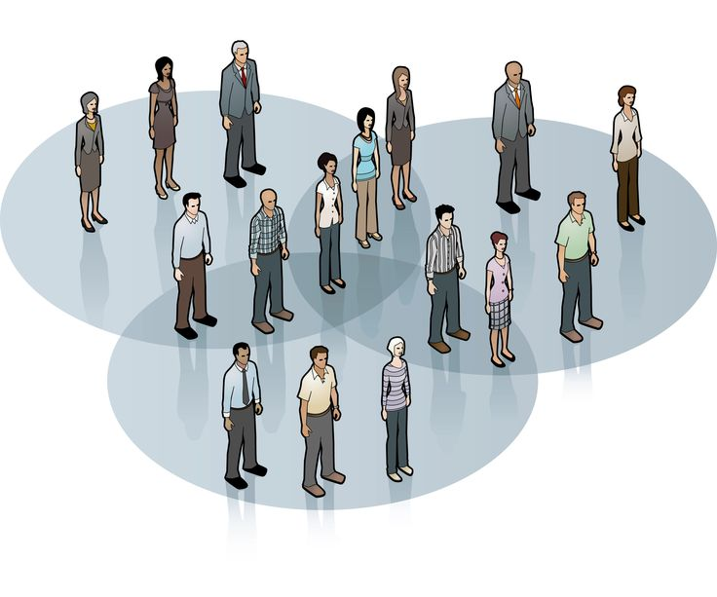
Data Set
The "Customer Segmentation" dataset from Kaggle is designed to assist in classifying customers into distinct segments based on various attributes.
Two data sets were provided:
Train data with Features and "Segmentation“
Test data with Features and without "Segmentation"

Slide 5
Data Set Description(1)
Feature | Describtion | Values | Ranges
ID | Unique identifier for each customer. | 6-digits INT random numbers | 458982 to 467974
Gender | Gender of the customer. | Male and Female | N/A
Ever_Married | Marital status of the customer. | Yes and No | N/A
Age | Age of the customer. | INT values | From 18 to 89, with a median of 40 years
Graduated | Whether the customer is a graduate. | Yes and No | N/A
Profession | Profession of the customer. | Healthcare,Engineer,Lawye,rEntertainment,Artist,Executive,Doctor,Homemaker,Marketing | N/A
Work_Experience | Years of work experience. | INT values | From 0 to 14 years, with a median of 1 year

Slide 6
Data Set Description(contd)
Feature | Description | Values | Range
Spending_Score | Spending score of the customer. | Low, Average, and High. | N/A
Family_Size | Number of family members, including the customer. | INT values | From 1 to 9 members, with a median of 3 members
Var_1 | Anonymized category for the customer. | Cat_1, Cat_2, Cat_3, Cat_4, Cat_5, Cat_6, Cat_7 | N/A
Segmentation | The segment to which the customer belongs. | A,B,C,D | N/A

Slide 7

Data Collection and Preparation
The "Customer Segmentation" dataset from Kaggle is designed to assist in classifying customers into distinct segments based on various attributes.
Two data sets were provided:
Train data with Features and "Segmentation“
Test data with Features and without "Segmentation"

Slide 8
Data Collection and Preparation(1)
Data collected from Kaggle: Customer Segmentation

Slide 9
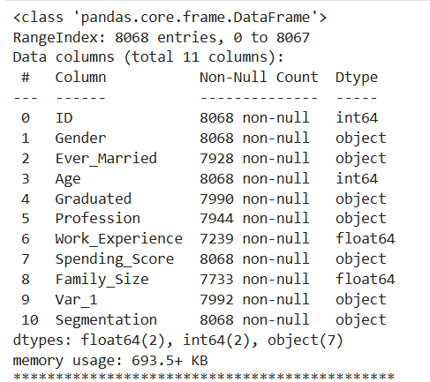
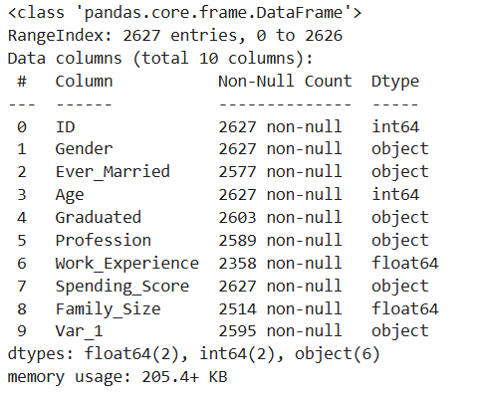
Exploring training and testing data
Training Data
Testing Data

Slide 10
Next preparation steps were completed after EDA

Slide 11

Exploratory Data Analysis (EDA)

Slide 12
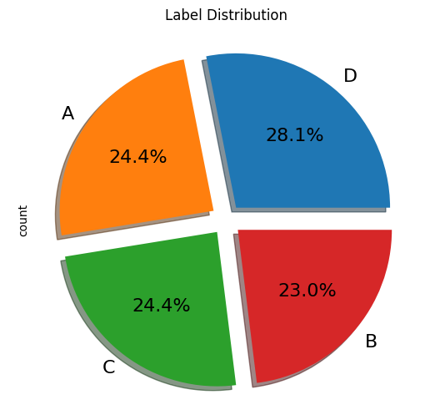
Target Distribution
Labels are balanced; thus, no need for over/under-sampling techniques.

Slide 13
1) Numerical Features

Slide 14
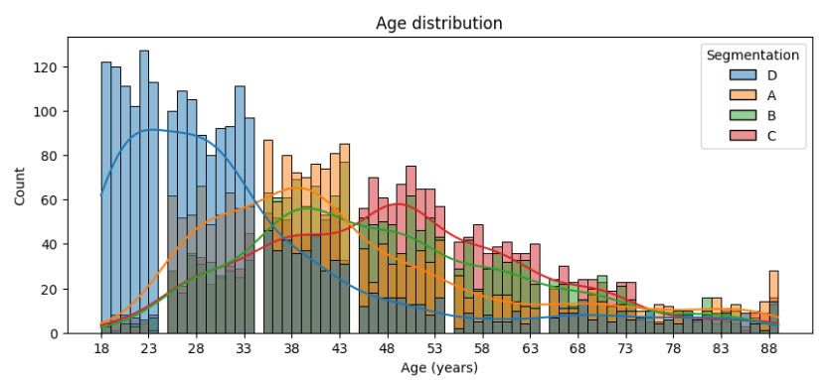
Age Distribution
18-34-year-olds, were more likely to be in Segment D
not, were more likely to be in segment A
45–60-year-olds were more likely to be in segment B
60 and more year-olds were more likely to be on
segment C, with overlap around 38–43
To decide if this could be applicable or not, we will back to this later

Slide 15
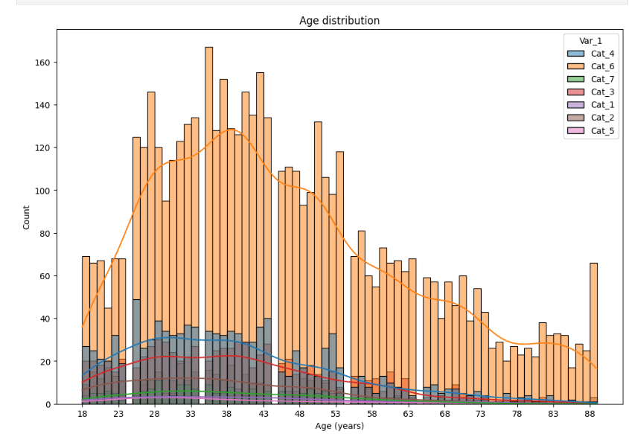
Age Distribution by Var_1
Most Age groups lie under Cat_6
No Clear relationship

Slide 16
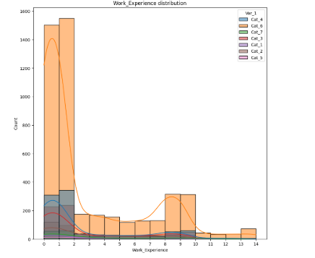
Work_Experience and Var_1
All work experience years lie under Cat_6
No Clear relationship

Slide 17
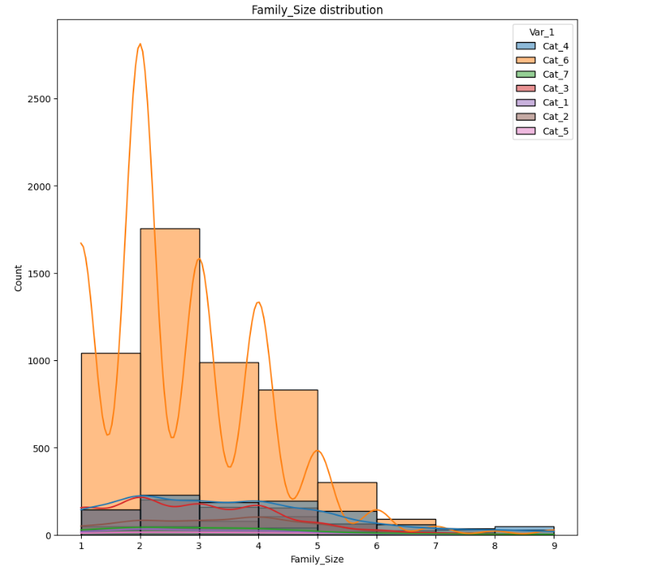
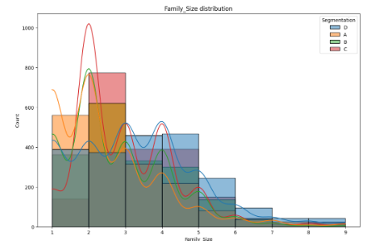
Segmentation and Var_1 with family size
Most families with 3 members or more lie under segment D

Slide 18
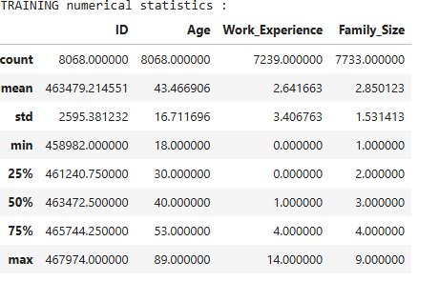
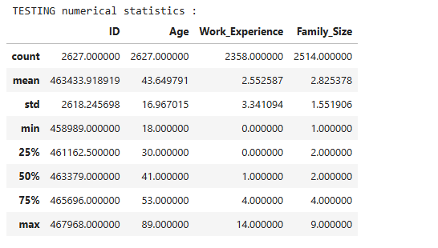
Numerical statistics

Slide 19
2) Categorical Features

Slide 20
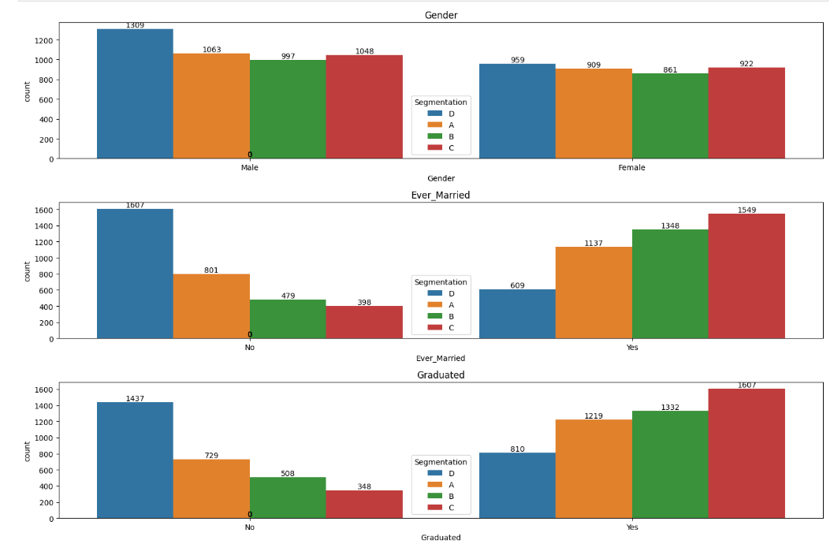
Gender
The proportion of male and female customers is almost equal across all segments
there is no strong indication that the segmentation is influenced by gender.
So, we might drop it

Slide 21
Ever_Married
Segment D dominates unmarried customers, while segments A, B, and C have a significantly higher representation for married customers.
this feature may be an influential factor in segmentation, with segment D being more prevalent among unmarried customers and the other segments towards married customers.

Slide 22
Graduated
Non-graduates have a higher representation in segment D than graduates.
Graduates also occupy segments A, B, and C, with a high distribution and slight difference.
So it can be said that segment D mostly represents less educated customers.

Slide 23
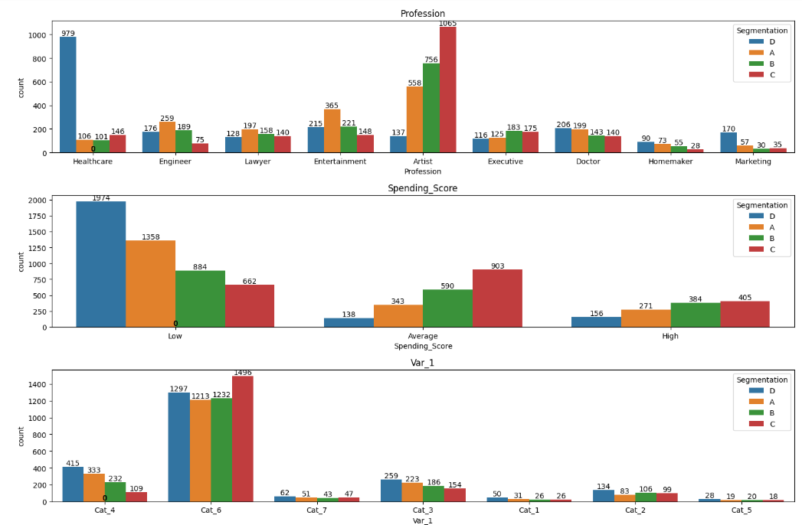
Profession
Healthcare is dominated by segment D, which appears to be fairly evenly distributed across the other segments.
Engineers, lawyers, executives, and doctors are roughly evenly distributed across all segments.
Artists are also overrepresented in segment C, indicating a strong relationship between this occupation and the segment.
Finally, homemakers are overrepresented in segment D.
Here, it can be argued that proficiency strongly influences segmentation for certain segments.

Slide 24
Spending Score
Segment D dominates the low spending score, followed by segment A.
Segment C is prominent in the average spending score;
Finally, the high spending score is almost equally distributed.
Here we conclude that segment D represents low spenders and segment C represents medium and high spenders.

Slide 25
Var_1
Cat_6: Dominates across all segments followed by cat_4 but with equal distribution between all segments.
but cat_7 and cat_5 are rare across all segments.
So, Var_1 influences the segmentation

Slide 26
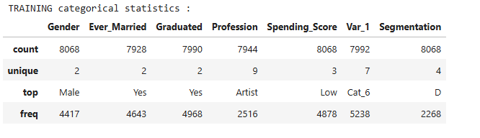
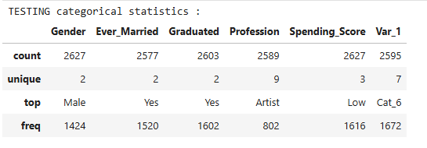
Categorical statistics

Slide 27
Summary
D: tend to represent young, unmarried, undergraduates, and low spending scores.
A: Fairly similar across most features.
B: Fairly similar across most features too.
C: higher in average spending score, graduates, and some professions such as artists. It could be a VIP segment.

Slide 28
Data Collection and Preparation(2)

Slide 29
Data Leakage Problem
the overlap between training and testing datasets was based on the ID column.
This is done by :
Determining the percentage of the training set’s unique IDs that are also found in the testing set.
Determining the unique IDs in the testing set that are not in the training set.
Merging the test set with the train set based on ID:
Percentage of Common IDs: 28.90%
Common IDs: 2332
Unique IDs in Test Set: 295

Slide 30
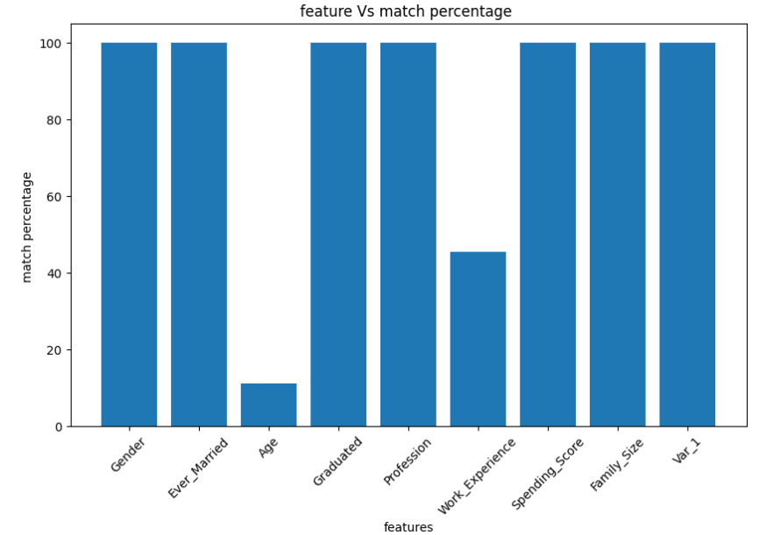
Data Leakage Problem
The results show a high percentage of identical values between the two datasets with similar IDs
100% or a high percentage of identical features between the training and testing datasets enable the model to remember the relationships between these features.
When these values appear in the test dataset, the model will predict the correct labels because it sees the actual set of features and values during training.
small ratio matching percentage (11.19% for Age, and 45.56% for work experience): This indicates a low risk of data leakage for them

Slide 31
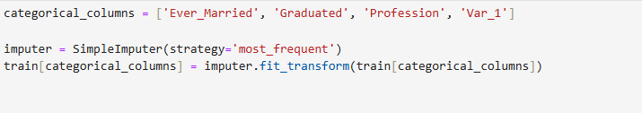
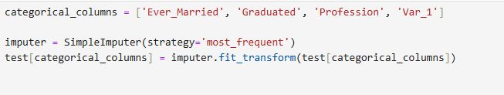
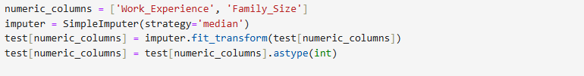
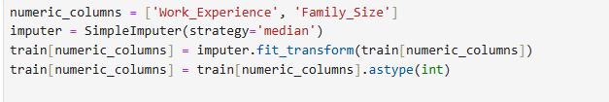
Handling Missing Values
The missing Values were handled in both training and testing sets.

Slide 32

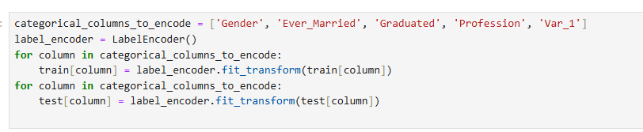
Encoding Categorical Values
The categorical Values were encoded in both training and testing sets.

Slide 33
Data Leakage Solving
Removing common rows that have the same ID from the test dataset.
Clustering data in the resultant set after dropping rows with common IDs(Predictive model)
Saving it in a new .CSV file for easier use called merged_data_with_segmentation.csv

Slide 34
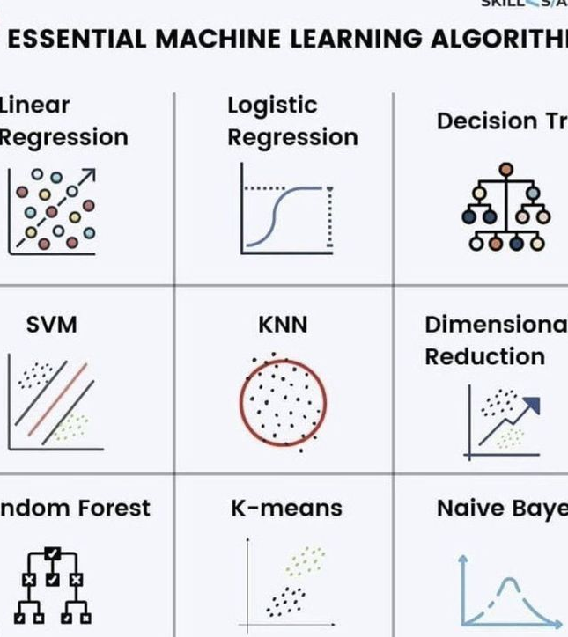
Model Selection and Building

Slide 35
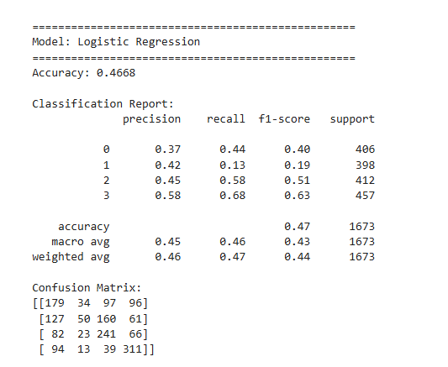
Logistic Regression

Slide 36
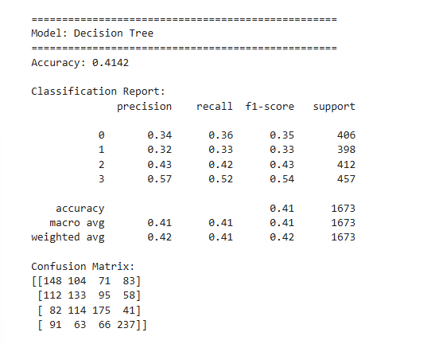
Decision Tree

Slide 37
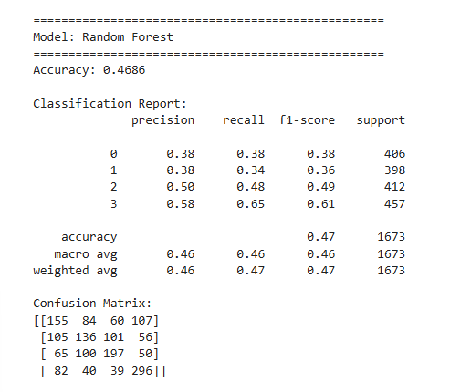
Random Forest

Slide 38
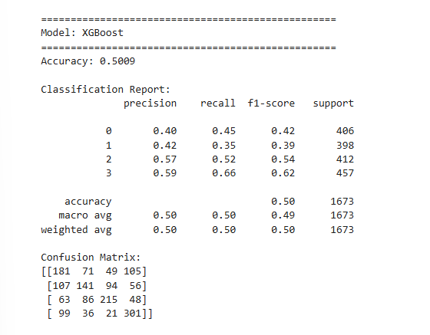
XGBoost

Slide 39
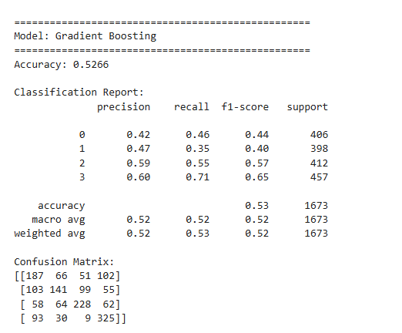
Gradient Boosting
This is the best model

Slide 40

Hyperparameter Tuning

Slide 41
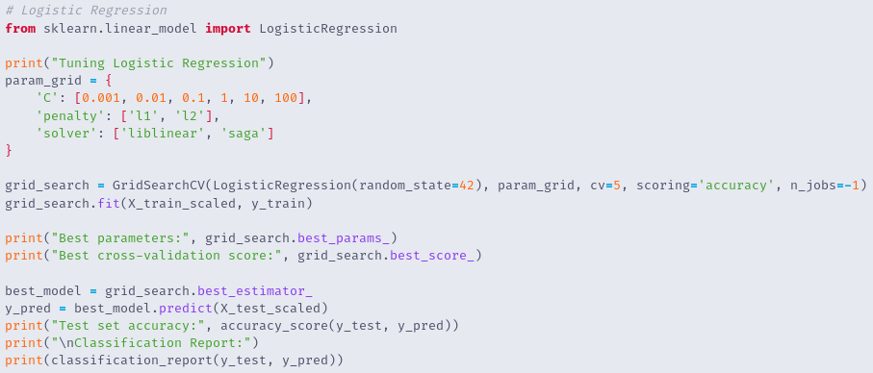
Logistic Regression

Slide 42
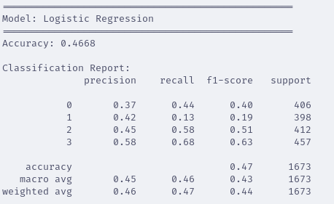
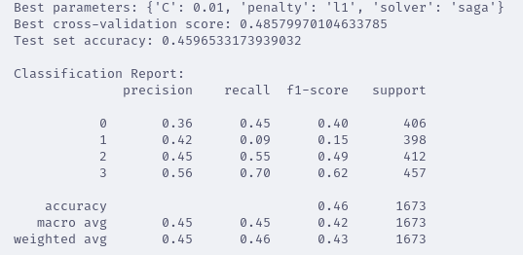
Logistic Regression
Slight decrease in final performance
Did not enhance Recall for the class
Dragged down the whole performance

Slide 43
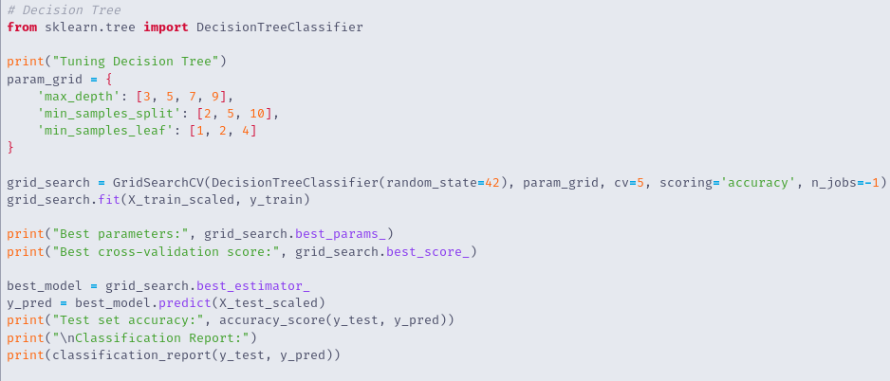
Decision Tree

Slide 44
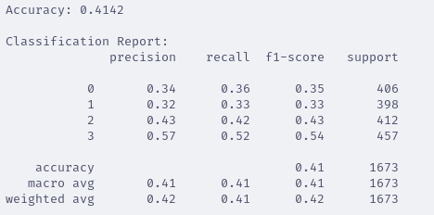
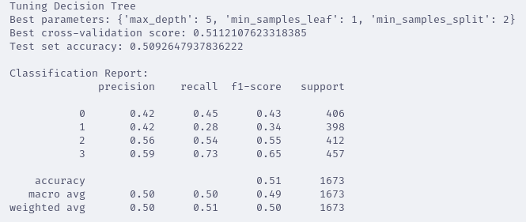
Decision Tree
Performed best with class 3 and class 2 but class 1 remained challenging
Showed an increase in overall accuracy
Better generalization to the test set

Slide 45
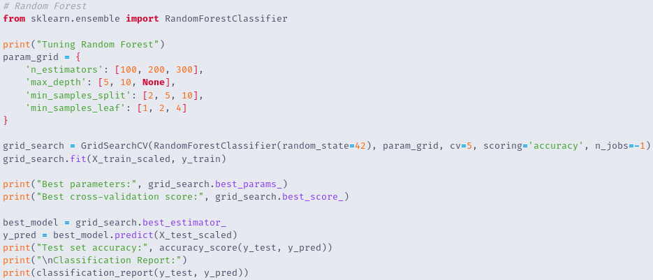
Random Forest

Slide 46
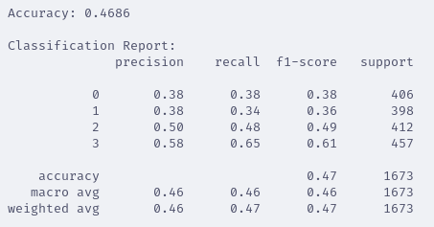
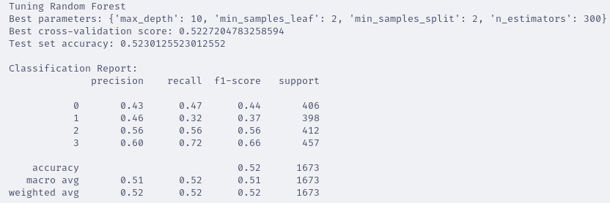
Random Forest
Performed best and improved with class 3 and class 2
Showed a meaningful increase in final performance
Indicated that tuning process improved generalization and performance

Slide 47
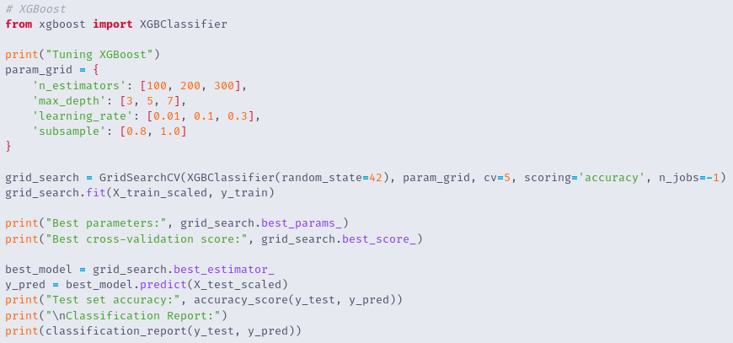
XGBoost

Slide 48
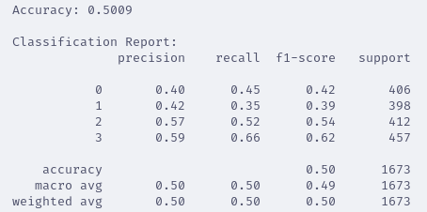
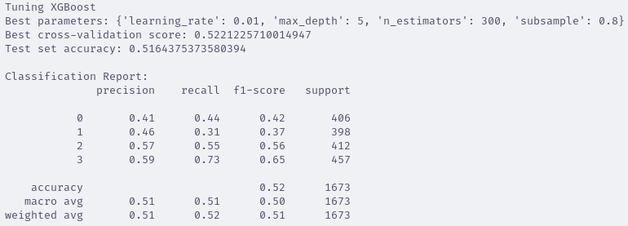
XGBoost
Performed best and improved with class 3
Class 2 remains same
Showed an increase in final performance
Slightly increasing the accuracy indicating better generalization

Slide 49
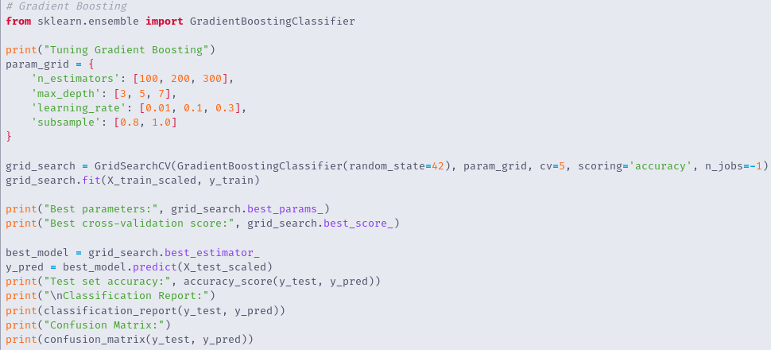
Gradient Boosting

Slide 50
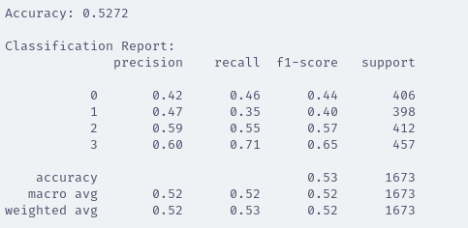
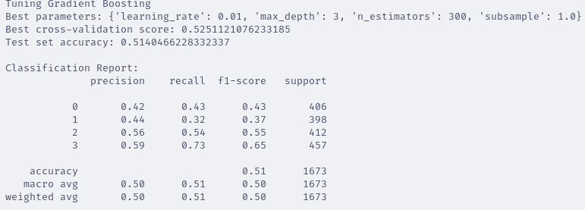
Gradient Boosting
Performed best and improved with class 3 but Class 0 and Class 1 remain weaker
Didn't improve test accuracy
Default Gradient Boosting model had better performance

Slide 51

Prediction
Demo

Slide 52
Thank you

